Slide 1
Administrative Services Program Review
Facilities

Slide 2
Administrative Services Mission Statement
Administrative Services Division is committed to providing an exceptional learning environment by providing the highest quality support services in the most effective and cost efficient manner, with an emphasis on integrity, customer service and continuous improvement.

Slide 3
Facilities Positions
Position | Status
Director District/Campus Facilities, Operations & Maintenance | Vacant
Administrative Assistant III | Vacant
Manager of Campus Projects | Vacant
Physical Education Supervisor | Vacant
PE Facilities Technician | Filled
Campus Operations Assistant | Filled

Slide 4
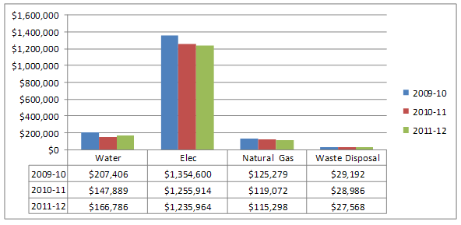
Facilities KPI’s
Sustainable practices producing results

Slide 5
Facilities’ Faculty & Staff
Satisfaction Surveys
Satisfaction | Fall 2011
Communication of facility projects and issues | 79.9% were satisfied 14.6% were neutral 5.5% were dissatisfied
Comfort of classroom furnishings | 67.0% were satisfied 19.8% were neutral 13.2% were dissatisfied
Response to ADA needs | 75.7% were satisfied 18.4% were neutral 6.0% were dissatisfied
Adequate campus parking | 63.5% were satisfied 13.3% were neutral 23.2% were dissatisfied

Slide 6
Facilities Student
Satisfaction Surveys
Satisfaction | Fall 2011 | Fall 2010
Promptness with which safety hazards are removed | 96.5% were satisfied | 96.5% were satisfied
The ability of the new buildings and labs to meet student educational needs | 95.1% were satisfied | 95.5% were satisfied
Condition of classroom furnishings | 88.5% were satisfied | 88.6% were satisfied
Comfort of classroom furnishings | 83.4% were satisfied | 84.6% were satisfied

Slide 7
Facilities KPI’s
Project Funds | Funds Expended 2011-2012 | Funds Expended 2010-2011
Scheduled Maintenance | $462,658 | $91,504
Capital Outlay fund 41 | $3.8 million | $1.9 million
Proposition R Funds (fund 42) | $18 million | $14.9 million
Revenue generated from Facilities use and leases | $88,365 | $84,879

Slide 8
Facilities Contributions to
Institutional Improvements
 | Projects Completed
Facilities Master Plan Progress College Goals 1,2,3,4,5,6,7,8,9,10,11 | Completed Griffin Center Completed Student Services & Administration Bldg. Completed Modular Village deconstruction
Scheduled Maintenance Plan Progress Supports College Goals 6, 7, 11 | Completed 6 roofing projects Epoxy coated chillers Repaired and upgraded storm drain system in 50’s Blgs. Replaced 2 inefficient boilers, in design for 3rd Replaced 2 inefficient air handlers, in design for 3rd
Sustainability Efforts Supports College Goals 2, 3, 6, 7, 11 | Completed Drought tolerant landscape zones Retrofitted parking structure lighting Completed CalSense Irrigation control system LEEDS Certification on buildings 60 and 10
Safety Resolution Supports College Goals 2, 3, 6, 7, 10, 11 | HazMat Business Plan completed and approved Completed Firescape defensible space project Completed Nature Preserve trail clearing
Architectural Barrier Removal Progress Supports College Goals 1, 2, 4, 7, 10, 11 | Completed room 220 and 370 remodels Installed braille signs as part of signage master plan Installation of 7 automated entry doors

Slide 9
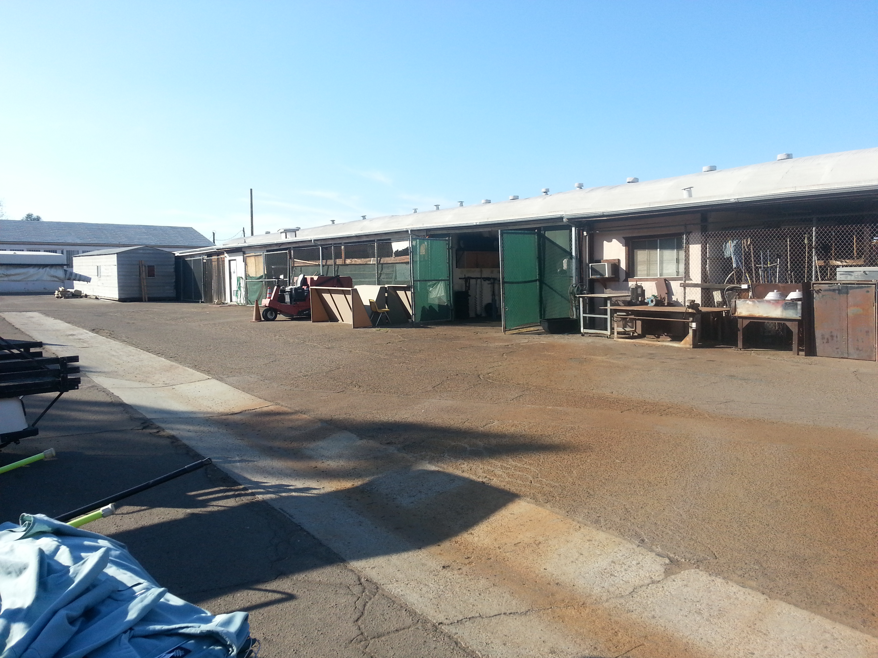
Facilities Program Needs Identified by Program Review
To preserve vital college information and to more efficiently perform maintenance and construction activities the college blue prints need to be scanned into a searchable data base.
To continue to meet recycling requirements, replace cardboard bailer
To ensure college facilities needs are prioritized, planned and communicated, assist with the development and implementation of Faciltieis Master Plan

Slide 10
Facilities Program Needs Identified by Program Review
To improve classroom environment and satisfaction survey results update classroom furnishings & furnishing standards
To improve safety and to increase the effectiveness of services provided to the campus, replace the Facilities and Maintenance compound
To provide the critical level of supervision, support services, and project communication Fill vacant Director and Administrative Assistant position

Slide 11
Facilities Goals Based on Program Review Analysis
Identify and incorporate sustainable practices and technologies in all construction and remodel projects
Assist in the identification, prioritization and completion of scheduled maintenance and Facilities Master Plan projects
Seek college funding to implement blue print scanning project
Increase revenue generated by facilities from outside sources including cell towers and facility rentals
Pursue appropriate staffing levels that will allow for proper coverage and supervision of college facilities

Slide 12
Administrative Services Program Review
Custodial

Slide 13
Custodial Positions
Position | Status
Custodial Supervisor | Filled
Custodial Supervisor | Filled
Custodian, Sr. | Filled
Custodian, Sr. | Filled
Custodian - twenty three (23) positions | 20 Filled, 3 vacant

Slide 14
Custodial KPI’s
 | 2009-10 | 2010-11 | 2011-12
Building maintained per Custodian area by Gross Square Feet (less parking structure) | 20,307 | 23,155 | 23,155
Building Area to be Maintained | 84,614.00 | 96,477.83 | 96,477.83
Classroom Efficiency | 95.10% | 97.74% | 99.53%
Maintenance & Operations Expenditures per GSF (less parking structure) | $5.51 | $5.21 | $5.29

Slide 15
Custodial Student
Satisfaction Surveys
Satisfaction | Fall 2011 | Fall 2010
Courteousness of staff | 97.8% satisfied | 97.3% were satisfied
Cleanliness of classrooms and labs | 94.1% were satisfied | 93.8% were satisfied
Overall condition of classrooms | 95.0% were satisfied | 94.6% were satisfied
Level of supplies in restrooms | 80.6% were satisfied | 82.0% were satisfied

Slide 16
Custodial Faculty & Staff
Satisfaction Surveys
Satisfaction | Fall 2011
Courteousness of staff | 92.0% were satisfied 6.5% were neutral 1.5% were dissatisfied
Assistance with Special Set ups and events | 85.0% were satisfied 13.6% were neutral 1.4% were dissatisfied
Timeliness of staff response to requests for service | 80.9% were satisfied 10.8% were neutral 8.3% were dissatisfied
Cleanliness of classrooms and labs | 68.6% were satisfied 15.7% were neutral 15.7% were dissatisfied
Cleanliness of Restrooms | 58.3% were satisfied 19.6% were neutral 22.1% were dissatisfied

Slide 17
Custodial Contributions to Institutional Improvements (outcomes)
Provided single point of contact for special event set up preparations, achieved an 85% satisfaction rate(College Goal 2, 3, 4, 7, 10 )
Reallocated area assignments to cover vacancies within the custodial ranks. Increased student satisfaction rate with less staff (College Goal 3, 6, )
Implemented green cleaning chemical use to assist college in achieving LEEDS certification for buildings 60 & 10. (College Goal 6, 8, 11)

Slide 18
Custodial Needs Identified by
Program Review
To improve the efficiency and safely reach second floor equipment, a person lift is required.
To improve cleanliness of campus facilities, proper staffing levels need to be met. This includes the three vacant custodial positions
To improve access to campus communications and requests, the department needs to replace 2 of the four computers in the office
To improve efficiency, the custodial meeting, locker, and storage areas need to be replaced as part of the Master Plan upgrades to modular areas

Slide 19
Custodial Goals Based on Program Review Analysis
Improve classroom and lab cleanliness by filling vacant custodial positions as funding is available to .
Improve restroom cleanliness by changing cleaning schedules and assignments
Improve area inspection process including new digital format.
Continue to expand green cleaning strategies
Provide training to staff on new equipment operation and maintenance procedures

Slide 20
Administrative Services Program Review
Business Services

Slide 21
Business Services Positions
Position | Status
Business/Communication Services Supervisor | Filled
Budget Analyst | Filled
Account Clerk, Sr. | Vacant
Account Technician, Sr. (ASGC) | Filled
Business/Services Specialist | Filled
Business/Services Specialist | Filled
Business/Services Specialist | Filled
Mail Processor | Filled
College Cashier | Vacant
Assistant College Cashier | Filled
Assistant College Cashier (0.75FTE) | Vacant

Slide 22
Business Services KPI’s
 | 2009-10 | 2010-11 | 2011-12
Annual Expenditures Restricted & Unrestricted | $66,322,042 | $67,044,304 | $63,415,475
UGF Expenditures per FTES | $3,887.52 | $4,314.82 | $4,395.29
Requisitions Processed | 1,368 | 1,514 | 1,584
Travel Expenses | $96,334 | $132,249 | $142,799
Audit Exceptions | None | None | None
Facility Use Requests Processed | 955 | 1,536 | 1,753

Slide 23
Grossmont College Budget

Slide 24
Business Services Faculty & Staff
Satisfaction Surveys
Satisfaction | Fall 2011
Courteousness of staff | 89.4% were satisfied 6.6% were neutral 4.0% were dissatisfied
Professionalism in dealing with customer concerns | 88.3% were satisfied 9.0% were neutral 2.7% were dissatisfied
Timeliness in processing forms | 85.4% were satisfied 12.3% were neutral 2.3% were dissatisfied
Helpfulness in processing forms | 88.2% were satisfied 8.6% were neutral 3.2% were dissatisfied
Efficiency in processing transactions accurately | 88.7% were satisfied 9.8% were neutral 1.6% were dissatisfied

Slide 25
Business Services’ Student
Satisfaction Surveys
Satisfaction | Fall 2011 | Fall 2010
Courteousness of staff | 96.3% satisfied | 96.0% were satisfied
Efficiency in processing transactions accurately | 96.0% were satisfied | 96.2% were satisfied
Cashiers knowledge about services and policies | 96.1% were satisfied | 96.2% were satisfied
Helpfulness of switchboard operators | 95.4% were satisfied | 96.1% were satisfied

Slide 26
Business Services’ Contributions to Institutional Improvements (outcomes)
Ensured mailroom and switchboard stayed operational during building 10 move. Completed mailbox reassignment(College Goal 2)
Worked with Deans and Department Managers to identify $2.26 million in 2011-12 budget reductions(College Goal 1, 3, 4, 5, 6, )
Increased Facility Use, and expanded community use of campus facilities(College Goal 3, 6, 11)
(College Goal 1, 2, 3, 6)

Slide 27
Business Services Program Needs Identified by Program Review
To provide more effective, efficient service to the college, Business Services needs to replace antiquated computer and printing equipment.
To provide more effective, efficient service to the college, Business Services needs to fill vacant positions as funding becomes available.
To provide better accessibility to mail room equipment, and security to the Business Office, additional facility changes need to be implemented

Slide 28
Business Services’ Goals Based on Program Review Analysis
Improve communication with students regarding services offered
Provide professional development and cross-training opportunities for staff.
Work to develop processes that accelerate document tracking, processing, and distribution to better serve students, faculty, and staff
Increase Business Services participation is shared governance committees and councils where appropriate.

Slide 30
Administrative Services Program Review
Food Service

Slide 31
Bookstore Positions
Position | Status
Bookstore Manager (B&N’s) | Filled
Bookstore Supervisor | Vacant
Department Lead - Shipping & Receiving | Filled
Bookstore Purchasing Assistant | Filled
Bookstore Purchasing Assistant | Vacant
Bookstore Purchasing Assistant | Vacant
Account Clerk, Sr. | Vacant
Bookseller | Filled
Bookseller | Vacant

Slide 32
Food Service KPI’s
 | 2011-12 | 2010-11 | 2009-10
Sales | 2,369 | 337 | 14.3%
Number of Students Employed | 2,519 | 788 | 31.3%
Board of Health Rating | A Rating | A Rating | A Rating
Commissions | $34,881 | $15,060 | $21,683
Participation

Slide 33
SALES MIX PERCENTAGE

Slide 34
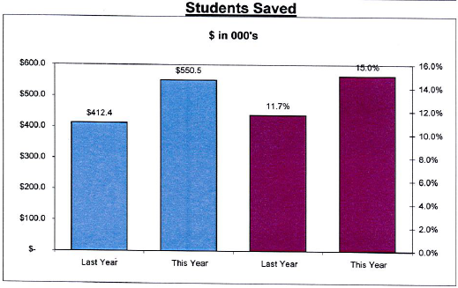
Bookstore’s KPI’s

Slide 35
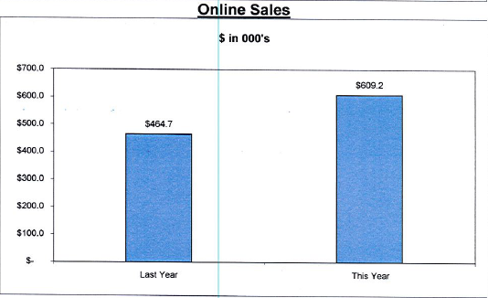
Bookstore’s KPI’s

Slide 36
Bookstore’s Faculty & Staff
Satisfaction Surveys
Satisfaction | Fall 2011
Courteousness of staff | 75.6% were satisfied 17.6% were neutral 6.9% were dissatisfied
Selection of hot and cold food choices | 35.6% were satisfied 24.5% were neutral 39.9% were dissatisfied
Cleanliness of food service area | 49.1% were satisfied 24.1% were neutral 16.8% were dissatisfied
Price of food items | 37.6% were satisfied 24.1% were neutral 38.1% were dissatisfied
Taste & Quality of Food | 40.5% were satisfied 26.2% were neutral 33.4% were dissatisfied

Slide 37
Bookstore’s Student
Satisfaction Surveys
Satisfaction | Fall 2011 | Fall 2010
Courteousness of staff | 92.2% satisfied | 89.6% were satisfied
Selection of hot and cold food choices | 75.9% were satisfied | 65.3% were satisfied
Speed of service | 84% were satisfied | 76.7% were satisfied
Cleanliness of food service area | 91.9% were satisfied | 87.1% were satisfied
Price of food items | 44.6% were satisfied | 45.9% were satisfied

Slide 38
Food Services Contributions to Institutional Improvements (outcomes)
Installed 3 additional registers to increase efficiency and shorten the wait times for students(College Goal 2)
Increased textbook rental program and increased the number of sections with rental textbooks available providing lower cost options for students(College Goal 1, 3, 4, 5, 6, )
Cross trained bookstore staff allowing the bookstore to provide efficient service to students and cover staffing shortages (College Goal 3, 6, 11)
Updated point of sales software providing additional functionality and improved processing of student financial aid orders. (College Goal 1, 2, 3, 6)

Slide 39
Bookstore Program Needs Identified by Program Review
To provide more effective, efficient service to the college, the bookstore needs to redesign the sales floor layout and replace rack and display systems.
To provide more effective, efficient service to the college, the bookstore needs to fill the Bookstore Supervisor and Book Purchasing Assistant positions.
To provide more cost effective book choices to students, the bookstore needs to improve the timeliness of faculty textbook adoption

Slide 40
Bookstore’s Goals Based on Program Review Analysis
Explore and implement strategies to reduce instructional materials costs to students
Increase textbook adoption response rate from faculty by 5% from 2012-13 levels.
Pursue appropriate staffing levels that will allow for the provision of efficient and effective service to the college community

